Slide 1
Exploratory Analysis of Geolocational Data
Zeroth phase presentation
Group 5
Ansar P A
Ayisha Ban
Jins Mathew Koshy
Muhammed Nazarudheen
Guide
Sharija PM
Notes:
Project Topic is eagd
Team members are

Slide 2
Abstract
This project involves the use of K-Means Clustering to find the best accommodation for students in Ernakulam by classifying accommodation for incoming students on the basis of their preferences on amenities, budget and proximity to the location.
Overview
Students may have to move to new city in order to achieve a good and high quality education. So we have designed a website to find what they need in the new city based on their preferences. We will provide a overview about all the places they prefer to know about, near their college or education institution. This project will involve the collection of data cleaning them and running KMean clustering and get geolocational data plotting results in map. We will use PHP for server side programing, Python for K-Mean Clustering and HTML, CSS and JavaScript for frontend website designing and will also use bootstrap framework for our website.
Notes:
As a students, at some point in time we all have to move out from our home town in order to achieve something in this fast moving effort intense world. There will be a huge load of pressure while we will go to a new city. With help of assisted system like ours it will be so much easy for the students to get know there new city in much easier and simpler way. This project will involve the collection of data cleaning them and running KMean clustering and get geolocational data plotting results in map.
KMean:
It is an iterative algorithm that divides the unlabeled dataset into k different clusters in such a way that each dataset belongs only one group that has similar properties.

Slide 3
Proposed Modules
Sign-up Module
collect some basic details of the user register new user
Login Module
This module will verify the user using username and password.
User input Module
Adding preference desired by the user.
Result(Map View) Module
Plot the output results in a map
Snippet View Module
The user will get snippet information about the the all the locations.
Rating and Review Module
rating and recommendations from the user to improve our services.
Notes:
Our system will have about 6 modules that will help us to achieve our desired result.
The input modules are :
1 Sign-up module collect some basic details of the user like the name, age, gender, contact number and email id.
And gives username and password
2 Login
3 user input this module is also called preference module at this stage we will collect the preference of the user in order to filter out and find the optimal output results for the user.
This module will collect more classified and organized details from the user using forms.We will provide a mixture of text boxes and drop-down menus to users for marking their answers.
4 Rating and Review
The output modules are:
We will provide the result in two views
1 Result (map view): This will show the result in the map the results will be plotted in the map as points and the user can look on to the map in order to find the results.
2 Snippet view will provide a list view of the data that are plotted in the map with a little briefing.
KMean:
It is an iterative algorithm that divides the unlabeled dataset into k different clusters in such a way that each dataset belongs only one group that has similar properties.

Slide 4
Software Requirements
→XAMPP
→Anaconda
→VS Code
→LucidChart
Hardware Requirements
The minimum hardware requirements:
CPU: 2 x 64-bit 2.8 GHz 8.00 GT/s CPUs.
RAM: 8 GB or 4 GB of 1600 MHz DDR4 RAM.
Storage: 150GB of free memory space.
Notes:
XAMPP: consisting mainly of the Apache HTTP Server, MariaDB database, and interpreters for scripts written in the PHP and Perl programming languages.
We will also use Anaconda for the management of python packages used in K-Means Clustering
VScode as code editer
LucidChart for brainstorming and creating conecpt visuals like uml and data flow diagrams
Hardware Requirement: these are the basic hardware requirement for the smoth running of the above mentioned software and for the implementation of the our project

Slide 5
Review of Relevant Literature
A real-time local-event detection system based on geolocation.
Modeling future spread of infections via mobile geolocation data and population dynamics. An application to COVID-19 in Brazil.
Notes:
1 Kazufumi Watanabe
The University of Electro-Communication, Tokyo, Japan
20th ACM international conference on Information and knowledge management
Makoto Okabe
The University of Electro-Communication, JST PRESTO, Tokyo, Japan
system for detecting local events in the real-world using geolocation information from microblog documents
Used twitter and geotagged data were only 0.7% so they implemented an automatic system for geotagging that identifies the location of non-geotagged documents
Advantages:
Our geotagging method successfully increased the number of geographic groups by about 115 times.
each group of documents, we extract co-occurring terms to identify its theme and determine whether it is about an event.
Disadvantage:
Only 25% accuracy
Usage of uncertain data having lots of risk factors in analysis them
2 Pedro S. Peixoto, Department of Applied Mathematics, Institute of Mathematics and Statistics, University of São Paulo
Sérgio M. Oliva, Department of Applied Mathematics, Institute of Mathematics and Statistics, University of São Paulo
geolocation data is a valuable asset in the assessment of movement patterns of a population
In this work, based on millions of anonymized mobile visits data in Brazil, we investigate the most probable spreading patterns of the COVID-19 within states of Brazil.
intended to help public administrators in action plans and resources allocation, whilst studying how mobile geolocation data may be employed as a measure of population mobility during an epidemic.
evaluate the risk of infection of each city within the states, by ranking them according to the time the disease will take to infect each city.
done by coupling the predicted mobility patterns with a standard SI model via a metapopulation model.
Advantages:
anonymized mobile phone data to detect population movement between cities. This framework is useful for a variety of applications
Intially it was very useful in making risk map for state.
remarkably good prediction of the spreading pattern, with only a few exceptions
Disadvantage:
sensitive to two modelling aspects: the initial condition distribution in the network and the mobility pattern.
initial condition given by having infection only present in the capital cities is reasonable considering the observed initial appearances of the disease in Brazil.
mobility pattern assumption is endorsed by the large penetration of the mobility dataset used.
K Mean :
Highly depending on initial values

Slide 6
Proposed System
Registration
LogIn
Adding Preference
Result
→Map View
→List View
Notes:
The whole system will comprise of the the following system:
The Register system will be used to add new user to our db and store their details and provide a unique username and password and this will help them to login back into their account anything.
The login mechanism will act as an authentication system which will let in the existing user by checking their username and password.
Adding Preference is the system that will help user to add their preference requests to the search results of the server in order to achieve the most meaningful and useful results for the user.
Results Window we will provide the results to user in two different view either a they can view it in the map as plotted points or they can see it as list of content with snippet of information about the it.

Slide 7
Data Flow Diagram
Level 0
User
Geolocational Analysis
Views Map
Notes:
At the zeroth level the user will input their preference

Slide 8
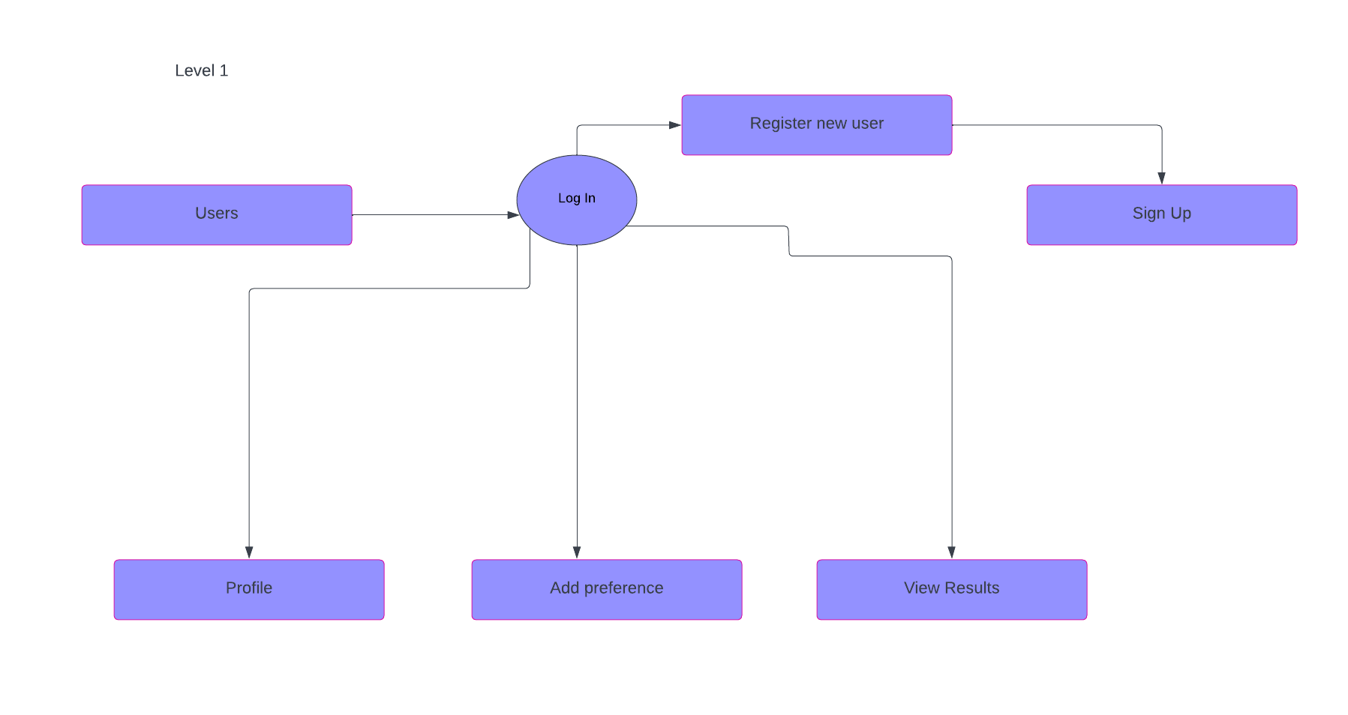

Slide 9
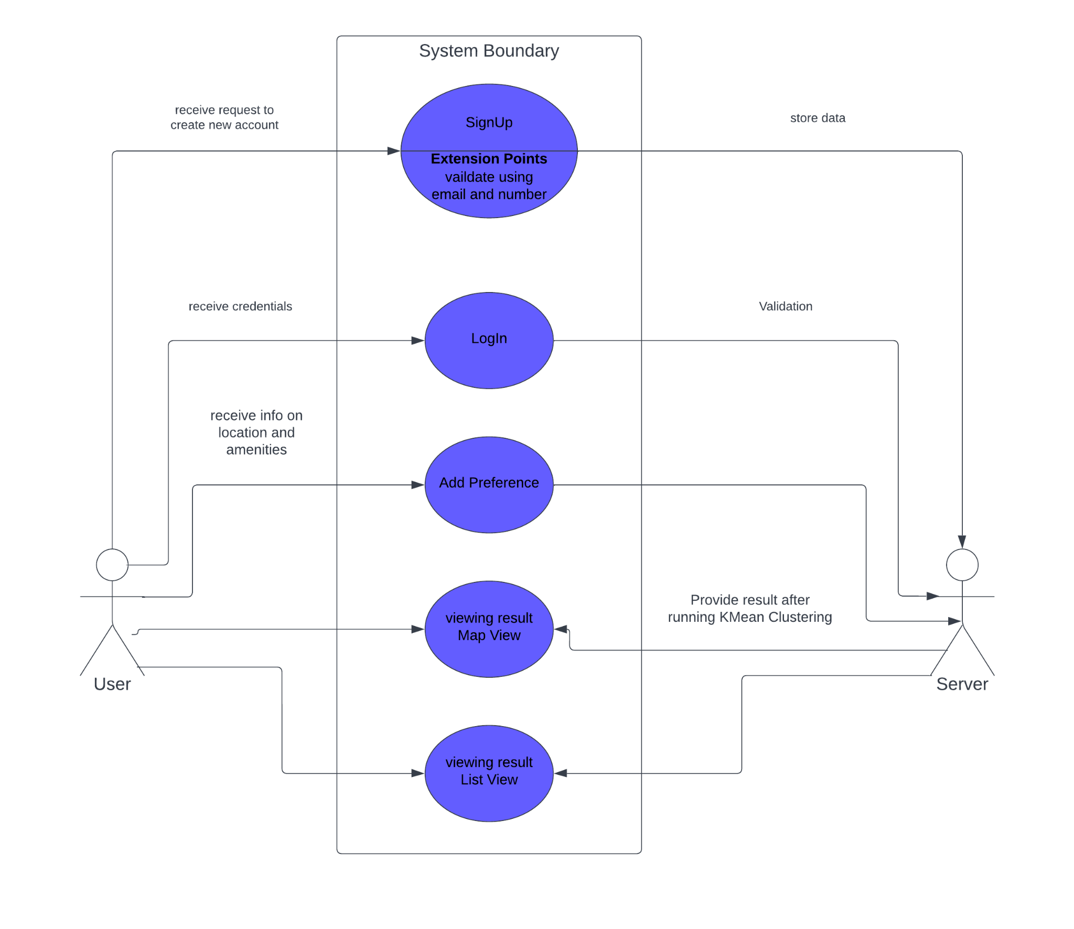
Use Case Diagram

Slide 10
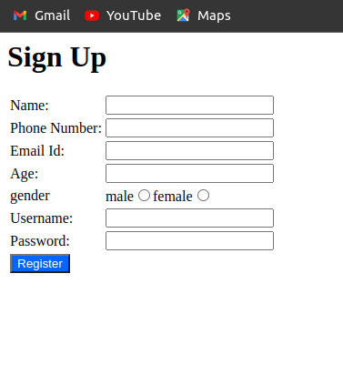
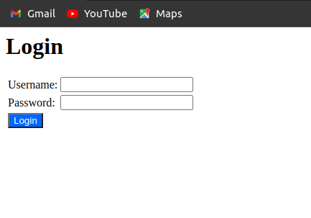
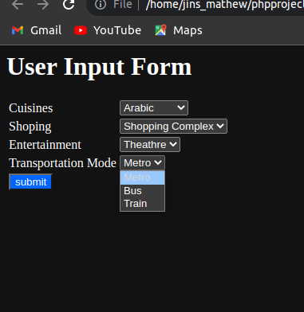
User Interface

Slide 11
Dataset
Zomato Restaurants Database
District Administrator Ernakulam
Dataset Search by Google
Database that stores user data
Notes:
Zomato dataset this analysis caters people who are striving to find their favorite cuisine at any locality.
District Administrator have:
College
Bank
Hospital
Convention Centre
Dataset search can be used to find data about malls

Slide 12
Conclusion
The aim of the project is use K-Means Clustering to find the best accommodation for students in Ernakulam by classifying accommodation for incoming students on the basis of their preferences on amenities, budget and proximity to the location.
As a result of this project we will be able to assist students in finding optimal residence options in a city like Ernakulam
With the help of datasets and the implement of K mean clustering algorithm we can plot our data in map and help in achieving the result.

Slide 13
Reference
CIKM '11: Proceedings of the 20th ACM international conference on Information and knowledge management October 2011 Pages 2541–2544
Modeling future spread of infections via mobile geolocation data and population dynamics. An application to COVID-19 in Brazil Pedro S. Peixoto, Diego Marcondes,
Cláudia Peixoto, Sérgio M. Oliva
Chen S, Yang J, Yang W, Wang C, Bärnighausen T. COVID-19 control in China during mass population movements at New Year. Lancet 2020; 395:764–766.
https://www.crio.do/projects/python-geolocational-data-analysis

Slide 14
THANK YOU

